Slide 1
The Reconquista
Crusade/Inquisition

Slide 2
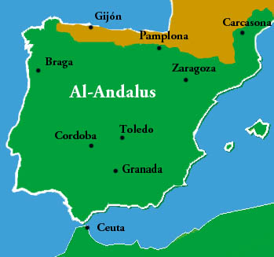
Umayyad's Take Spain
Charles Martel stops their advance 732

Slide 3
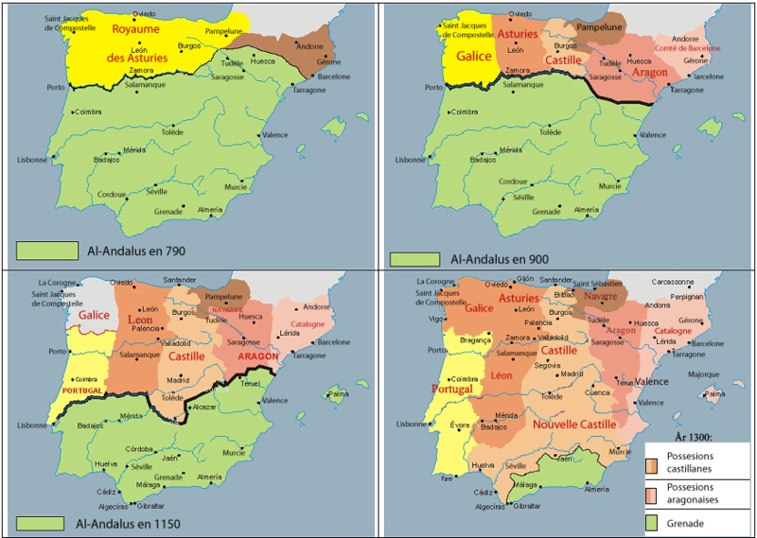
Christian Rulers began to push out the Muslims overtime.

Slide 4
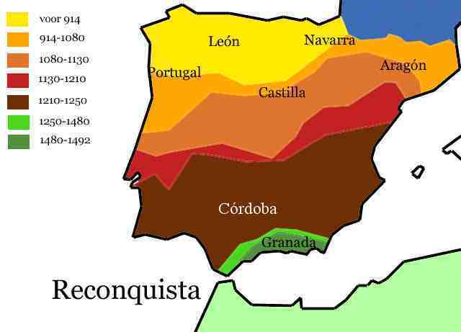
By the end of the 15th Century Granada was all that was left.

Slide 5
Queen Isabella and King Ferdinand
They used the Inquisition against Muslims and Jews. They even went after those who converted.
Thousands burned at the stake
1492 Granada fell and Muslims no longer had control over any part of Spain
Jews were ordered to become Catholics or leave the country. More than 170,000 Jews left forever. Many fled to Muslim lands like Constantinople.
Many Muslims did stay, but a second inquisition was instituted in the 17th century to push the final

