Slide 1
The Safavid and Mughal Empire

Slide 2
Seljuk Turk Empire (1063-1194)
Abassids rule only in name
Seljuk take over and spread empire into Byzantine territory (Macedonian)
No real central government/short lived
Prompted 1st Crusade
No central gov. made it hard to ban together

Slide 4
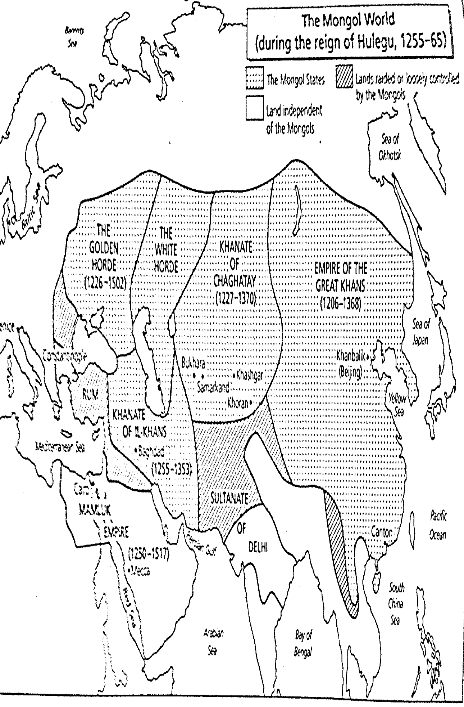
13th Century
Mongols will take over the area

Slide 5
15th and 16th Century Three Major Empires Emerge from Mongol Control
Ottoman Empire (Anatolia)
Safavid Empire (Iran)
Moghul Empire (India)
They will take a page from the Mongol play book and rule mostly through the military.

Slide 7
The Safavids Build An Empire
Heavy military rule
Oppressed subjects, but people liked the stability.
Squeezed between Ottoman and Mughal Empire.
Located in area of modern day Iran
Forced Shia’ conversion

Slide 8
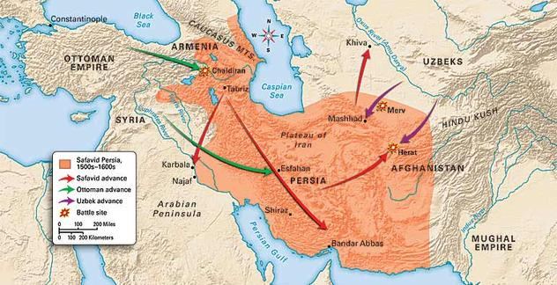
Safavid Empire

Slide 9
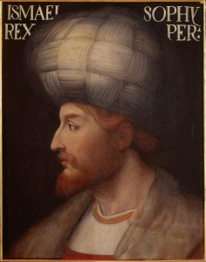
Important ruler: Isma’il
Seized most of what is now Iran at age 12.
Takes title of Shah – “King”.
Established a Shi’a Islam as state religion
Religious tyrant, forced conversion to Shi’a

Slide 10
Religious Violence
Isma’il forced conversion to Shi’ism
Anyone who did not convert was put to death.
Isma’il destroyed the Sunni population in Baghdad.
Ottoman Selim the Grim as a counter ordered the execution of all Shi’a (Nearly 40,000 died)

Slide 11
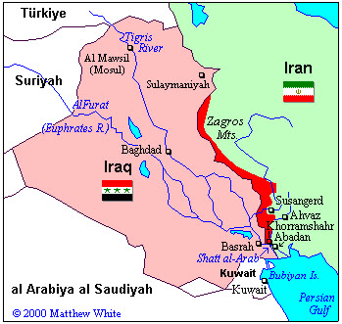
Battle of Chaldiran Outcome
Battle of Chaldiran (1514).
Using artillery Ottomans pound the Safavids into defeat. Safavids will adopt artillery after this battle
Border set up between two empires
This border still exists to this day.

Slide 12
Ottoman Empire
Most successful
Took on more of a Byzantine Influence than Mongol (civilians part of gov.)
Wanted to incorporate all in empire.
Janissaries- Christian slaves could become part of the elite guards

Slide 13
Look at lands Ottomans took from the Safavid Empire

Slide 14
Mughal Empire
Babur inherited a kingdom in the area that is now Uzbekistan and Tajikistan. He was 11 years old
Akbar (Barbur’s grandson)– Akbar equips his army with heavy artillery. Creates central government, but runs it with the military
He allowed religious freedom and got rid of the jizya.
Least pure of all the three major Muslim Empires.

Slide 15
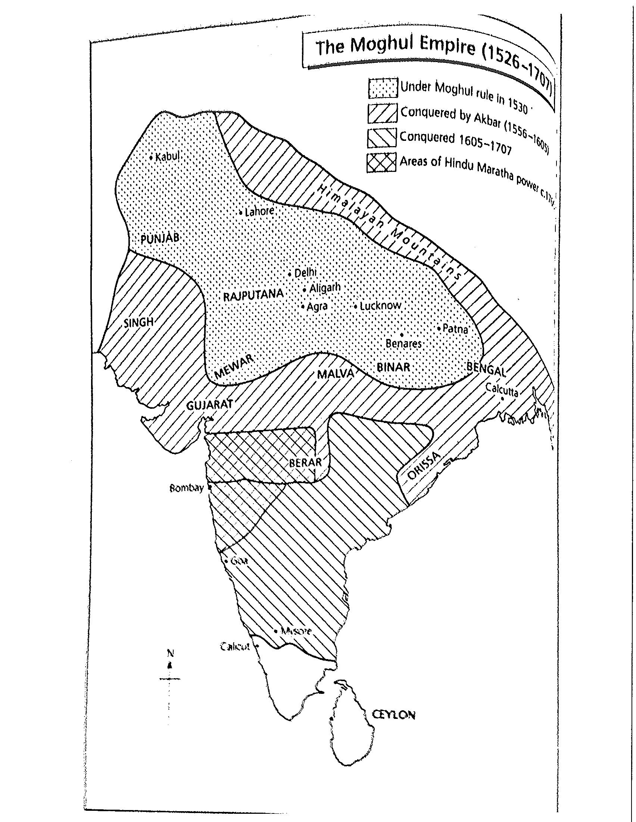

Slide 16
Akbar cont.
Religious tolerance (married princesses without forcing them to convert).
Gave land grants to bureaucrats but took them back when they died.
Created a graduated income tax (similar to here in the USA.

Slide 17
Shah Jahan
Could not tolerate competition assassinated all possible rivals.
Married a Persian Princess and fell in love.
She dies at age 39 while giving birth to her 14th child.
He builds a shrine.

Slide 18
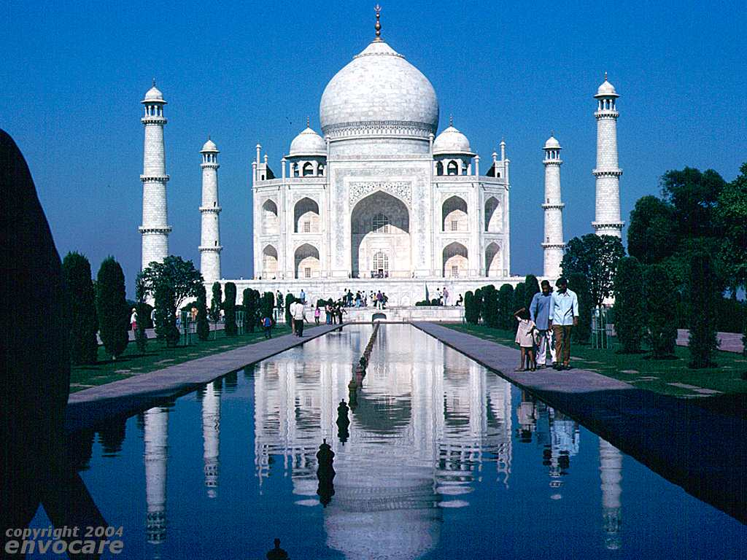
Taj Mahal

Slide 19
Suffering
People suffered under Shah Jahan’s rule. He spent money building gardens and monuments while people starved.
He over taxed his people.
The West took advantage of the now weakened Mughal rule and moved in on India. They wanted the spices.
Portuguese were the first Europeans to reach India, then Dutch, French and English.

Slide 20
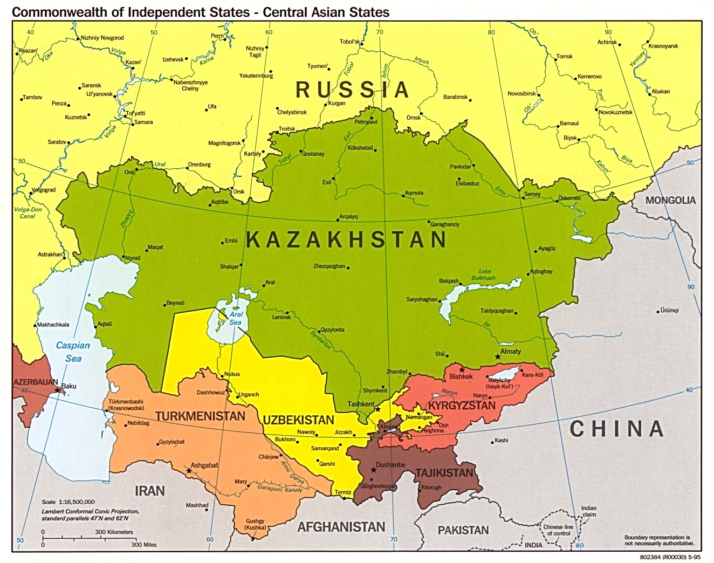

Slide 21
Shah Abbas (Abbas the Great)
Blends Ottoman, Persian and Arab culture.
Limited the power of the military
Demonstrated religious tolerance asked Christians to move to the cities to bring more people.
Changed capital/ known for art work.
Blinded ablest sons same issue as Ottomans

