Slide 1
Visigoths (Goths)
Lived on the delta of the Danube River
Attempted to invade Rome twice unsuccessfully.
Successfully invaded and held Rome for 3 days. Taking and destroying everything 409A.D.

Slide 2
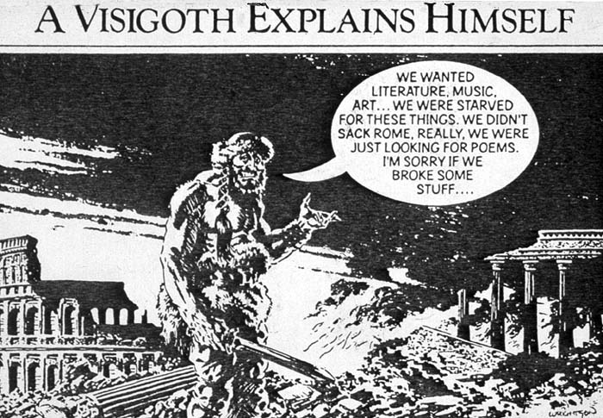

Slide 3
Ostrogoths
The Ostrogoths take over the Italian area (Rome) 493 a.d.
There they rule until Justinian takes them over.
They will fight back the lands in a long 20 year war
absorbed into the Lombards
The interesting thing about the Ostrogoths is that they did not separate Romans from Barbarians. With other barbarian tribes, the barbarians were tried in military courts and Romans in civilian. Though all barbarians faced religious issues.

Slide 4
Lombards
Named because of their long beards.
Worked their way down to Italy and they became Italians.
Franks will take them over, but much of their culture and influence will remain.

Slide 5
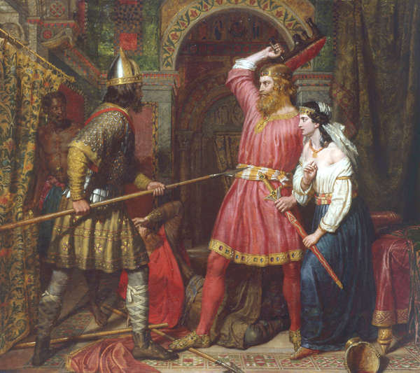
Lombards cont.

Slide 6
Vandals
Today the word ‘vandal’ reflects the dread and hostility the tribe caused in others because of their looting and pillaging. (455 A.D. Invaded Rome)
They kept gov in place. Became too rich and corrupt.
Byzantine Empire will invade
Soon after Vandals will disappear.

Slide 7
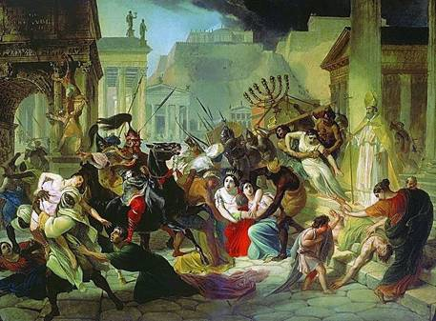
Vandals cont.

Slide 8
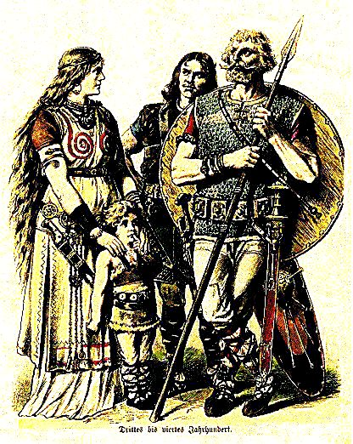

Slide 9
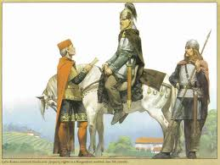
Burgundians
Great allies of Rome. Fought with Rome against Attila (so did the Franks, and Visigoths)
Allies of the Franks, helped Clovis to defeat Visigoths
Franks will later turn on them and take them over.

Slide 10
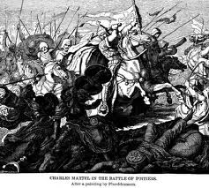
Franks
Used as a buffer, helping Rome.
Most important of the Barbarian tribes because they will be the ones to completely take over the west under the Merovingian dynasty, then the Carolingian dynasty.

Slide 11
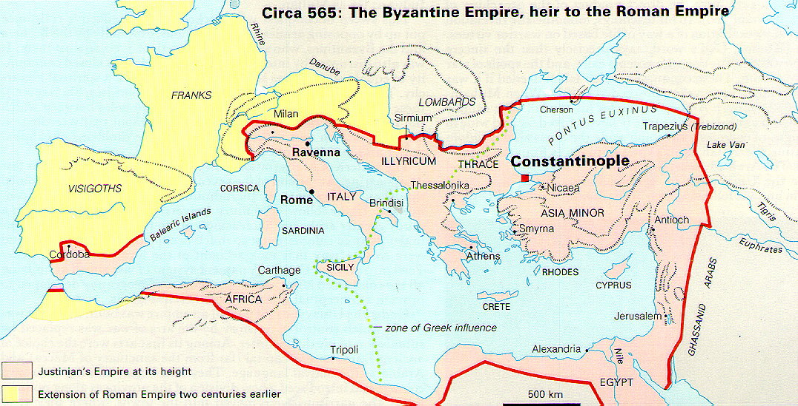
http://faculty.cua.edu/pennington/Law508/Justinianemp.htm

